Slide 2
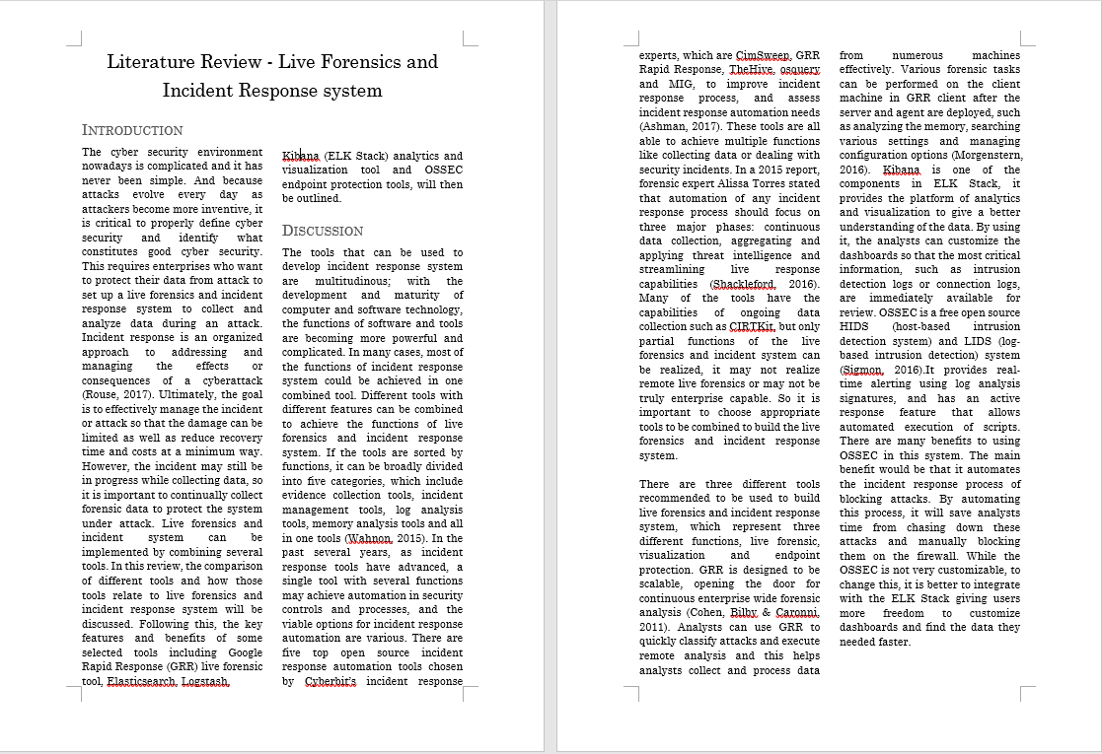
Literature Review

Slide 3
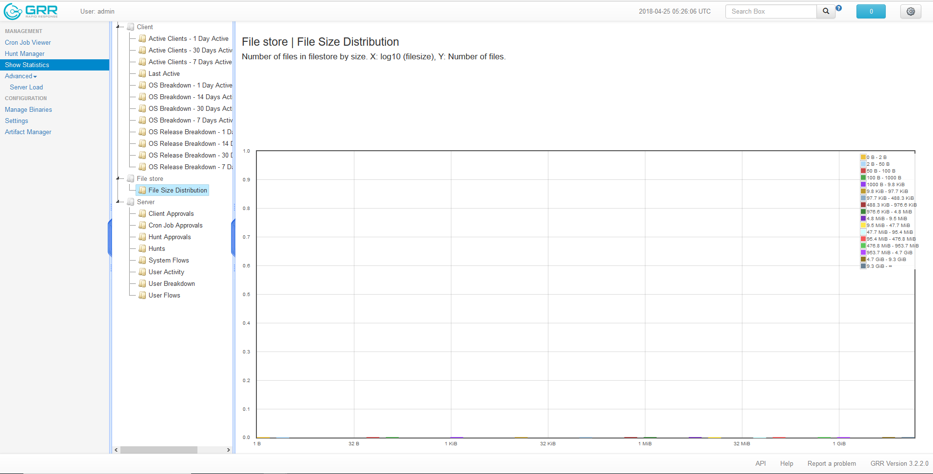
GRR Interface

Slide 4
project management
Meeting minutes, trello, Github etc.

Slide 5
ELK Stack

